Slide 1
BANK MARKETING
ANALYSIS
Name GitHub ID
Dhevin De Silva - moover9999
Keani Schuller - keanischuller
Olivier Larochelle - LarochelleOlivier
Tiffany Lagarde - tiffanylagarde
Valentin Najean - valnaj
Team Name : fourchetteurs
Repo:McGill-MMA-EnterpriseAnalytics/fourchetteurs

Slide 2
TABLE OF CONTENTS
01
02
03
04
05
06
CONTEXT & HYPOTHESIS
DATASET, EDA
& GOALS
MODEL
BUILDING
RESULTS & INTERPRETATION
THREATS TO VALIDITY
CONCLUSION & NEXT STEPS

Slide 3
01
CONTEXT & HYPOTHESIS

Slide 4
BUSINESS CONTEXT
The banking environment is very competitive, but can be rigid and traditional
Banks should look for innovative strategies to attract new clients and retain existing ones
The transition from traditional marketing approaches to data-driven strategies means a big shift in how banks engage with potential and existing customers
This requires an emphasis on the importance of leveraging customer data to personalize targeted marketing strategies
We want to use our bank marketing dataset to enhance the effectiveness of these marketing campaigns
This will allow banks to have more efficient allocation of marketing resources and higher conversion rates, which will ultimately increase their profitability

Slide 5
MODEL CONTEXT
Classification models enable us to predict whether a client is likely to subscribe to a term deposit, which allows banks to focus resources on clients with the highest likelihood to convert
Classification allows us to identify what make a client more likely to respond positively to a campaign, reduce marketing costs, and give insights into the factors influencing a client's decision to subscribe
Clustering allows us to segment the bank's clients based on various characteristics, identifying distinct groups within the client base with similar behaviors, preferences, or needs
Clustering allows the bank's marketing strategies to be tailored to the specific traits or needs of each segment, which can increase the effectiveness of their campaigns

Slide 6
CLASSIFICATION MODEL CONTEXT
Classification models enable us to predict whether a client is likely to subscribe to a term deposit, which allows banks’ targeted marketing campaigns to focus resources on clients with the highest propensity to convert
It allows us to identify characteristics that make a client more likely to respond positively to a campaign, letting banks personalize their outreach efforts
Focusing marketing efforts on individuals predicted to be interested in the product can reduce marketing costs by avoiding expenditure on unlikely prospects
Classification models’ predictive power gives insights into the factors influencing a client's decision to subscribe to a term deposit

Slide 7
CLUSTERING MODEL CONTEXT
Clustering allows us to segment the bank's clients based on various characteristics, identifying distinct groups within the client base with similar behaviors, preferences, or needs
With clear segmentation, the bank's marketing strategies can be tailored to the specific characteristics and needs of each segment, which in turn can increase the effectiveness of their campaigns
Clustering can also help uncover hidden patterns in our data that aren't obvious, which can reveal new opportunities for targeted marketing and product development
By understanding the different segments within the client base, banks can optimize the allocation of marketing resources, directing them towards segments with higher potential returns on investment

Slide 8
HYPOTHESES
Our hypothesis for our classification model is the following:
"Classification techniques will accurately predict which clients are more likely to subscribe to a term deposit based on their traits and interactions with previous campaigns."
Our hypothesis for our clustering model is the following:
"Clustering algorithms will identify distinct groups within the data, revealing their different patterns and characteristics. "

Slide 9
02
DATASET, EDA, & GOALS

Slide 10


DIRECT MARKETING CAMPAIGNS
Overview
Dataset from University of California Irvine’s Machine Learning Repository
45,211 rows and 21 columns
Marketing campaigns conducted via phone calls by a Portuguese banking institution
Objectives
Predictive classification goal: Determine whether clients will subscribe to a term deposit
Segmentation objective: Identify distinct client segments targeted by the marketing campaign
Subscribe to term deposit
Not Subscribe
Business Goals we want to archive with this data
Factors influencing client subscription decisions
Identification of patterns and trends in client behavior
Optimizing future marketing strategies
Potential for improving client engagement and subscription rates
Opportunities for targeted outreach and personalized campaigns

Slide 11
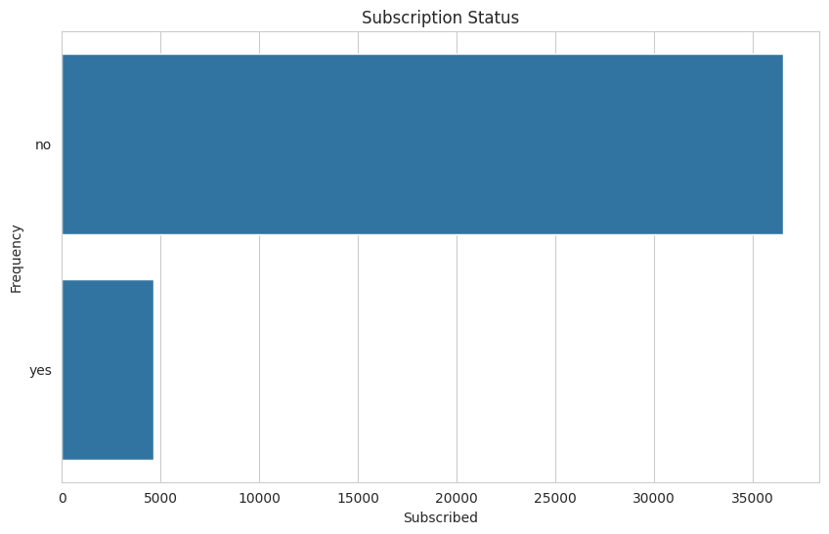
SUBSCRIPTION DISTRIBUTION
“Subscribed” is a binary variable indicated whether or not a client subscribed to a term deposit through the marketing campaign
The subscription status is our target variable for our classification model
The majority of customers didn’t subscribe to the term deposit
Over 35,000 chose not to
Only a little less than 5,000 did

Slide 12
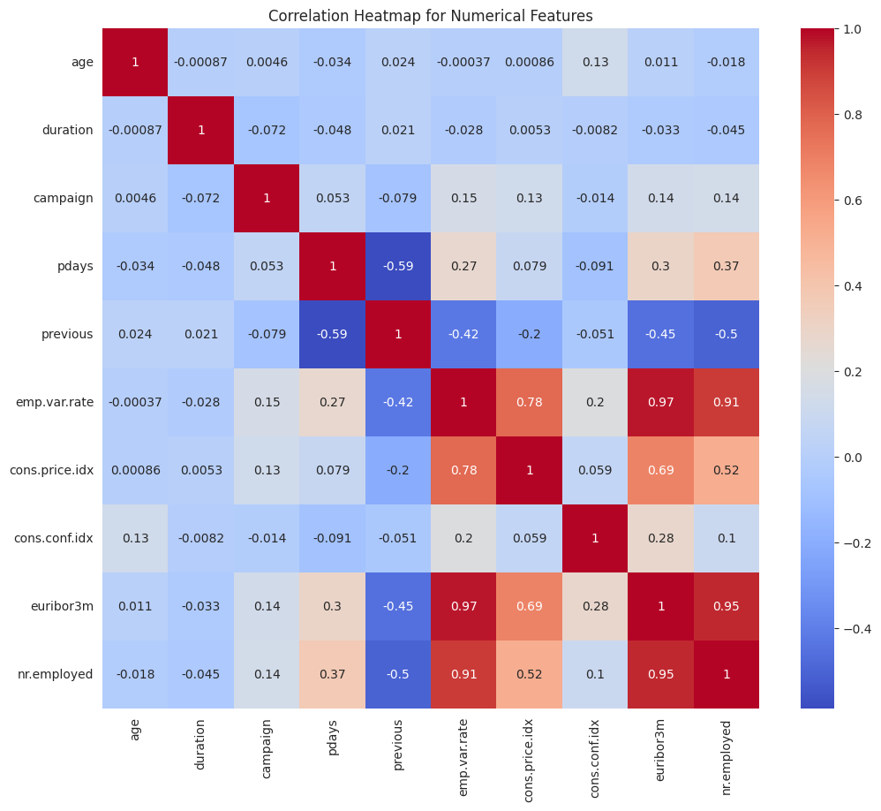
CORRELATION MATRIX
Correlation matrix between all the numerical predictors in the dataset
Overall, the majority of predictors have very low correlations
The highest correlation is between the Euro Interbank Offered Rate 3 month rate and the Employment Variation Rate, at 97%
The other variables with strong correlations between them are the Employment Variation Rate, the Consumer Price Index, the Euro Interbank Offered Rate, and the Number of Employees

Slide 13
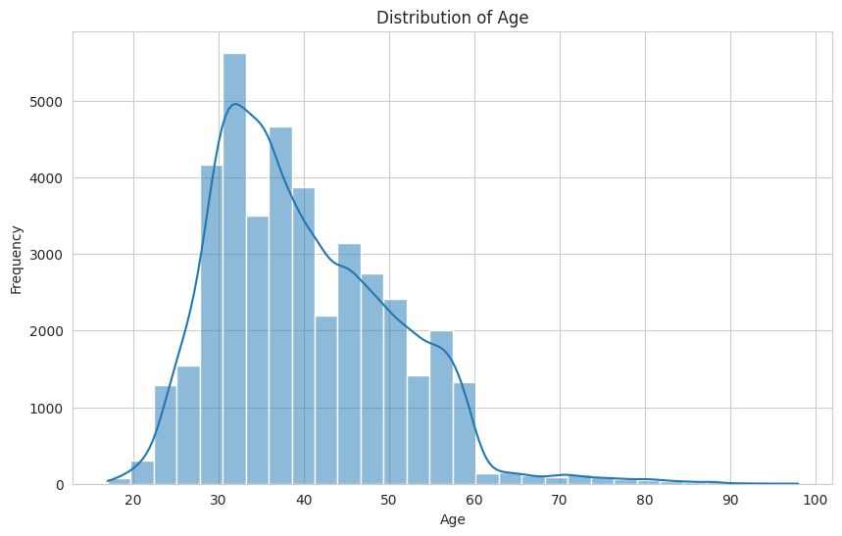
AGE DISTRIBUTION
The age distribution of those targeted by bank marketing is mainly those in their 30s
There is also a high frequency of customers in their 40s and 50s
Those in their 20s or before, and 60s or more are less targeted by the marketing campaigns
This makes sense, since people in their 20s-50s are part of the active working population

Slide 14
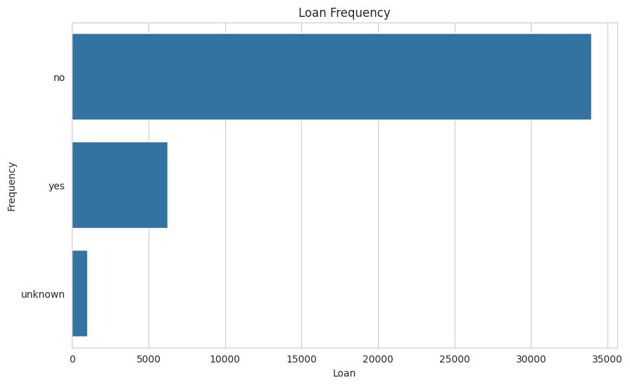
LOAN DISTRIBUTION
The large majority of customers don’t have loans with the bank
Around 34,000 of customers don’t have loans
There’s many less that do have loans or that are unknown
Only around 6,500 have loans
Around 1,500 are unknown whether or not they have a loan or not

Slide 15
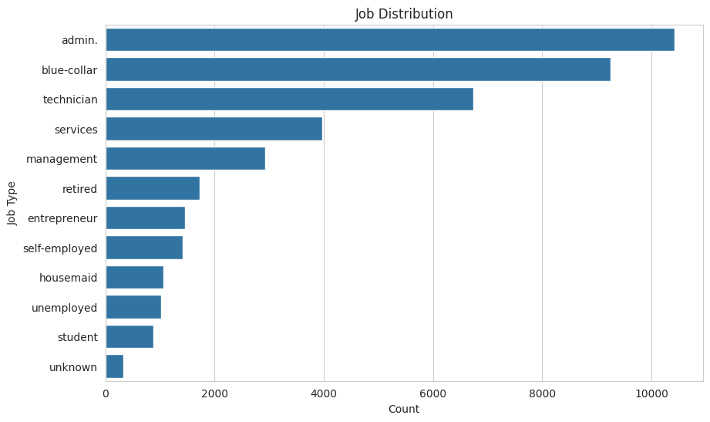
JOB DISTRIBUTION
Histogram showing the number of clients within each type of job
Admin in the most common job out of all the clients targeted
This is followed by blue collar workers and technicians
Very few of the clients targeted are students, which makes sense since they would have much less likely to need term deposits

Slide 16
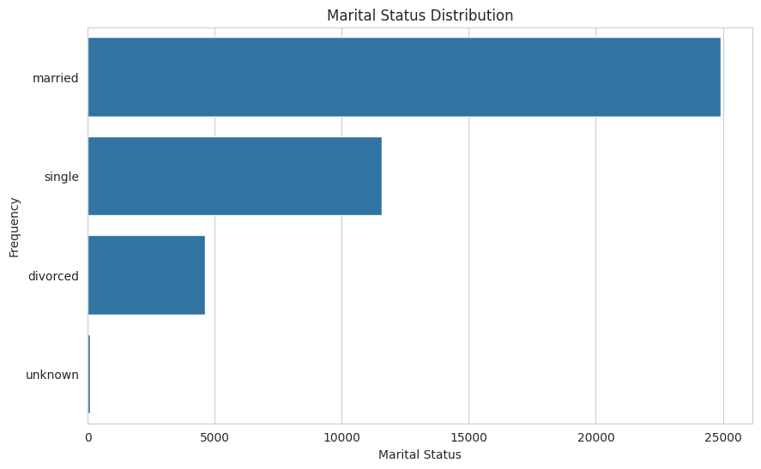
MARITAL STATUS DISTRIBUTION
Looking at the frequency of marital statuses among the clients
Overall, the majority of clients targeted are married
There are some that are single or divorced, but much less in comparison
This makes sense since based on the age distribution, most clients were between 30-50 years old
People in this age group are more likely to be married

Slide 17
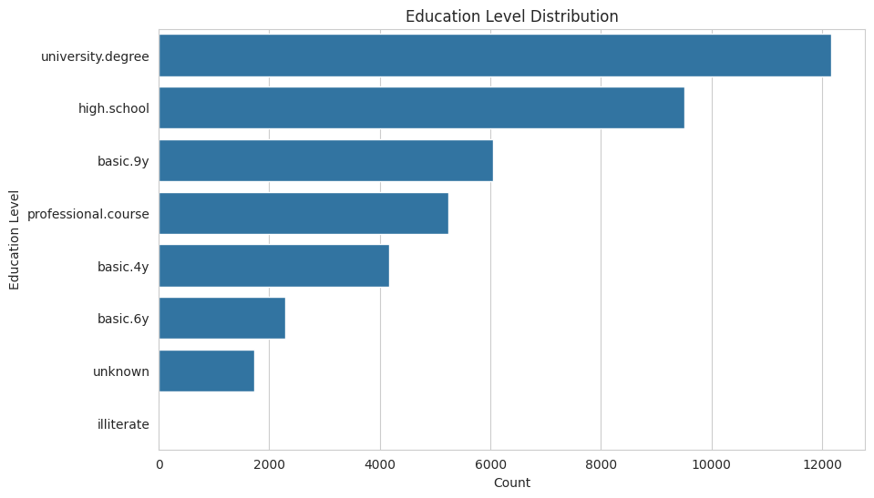
EDUCATION DISTRIBUTION
Looking at the number of clients within each type of education level they received
The highest number of clients targeted have a university degree
The disparity between the education levels are not very large
The second highest number of clients are those with high school degrees
There are no clients that are illiterate,which makes sense since public education in Portugal is free

Slide 18
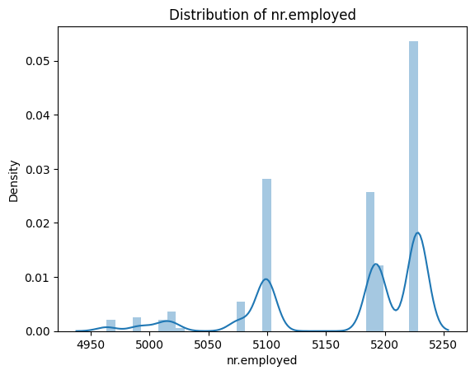
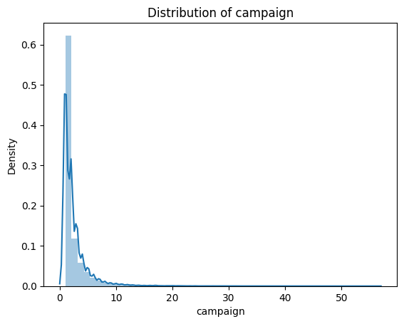
NUMERICAL DISTRIBUTIONS
There is a higher density of employees overall
The are most likely 0 to 10 marketing campaigns, making the distribution right-skewed

Slide 19
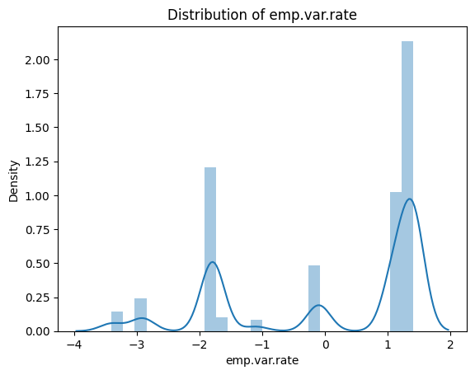
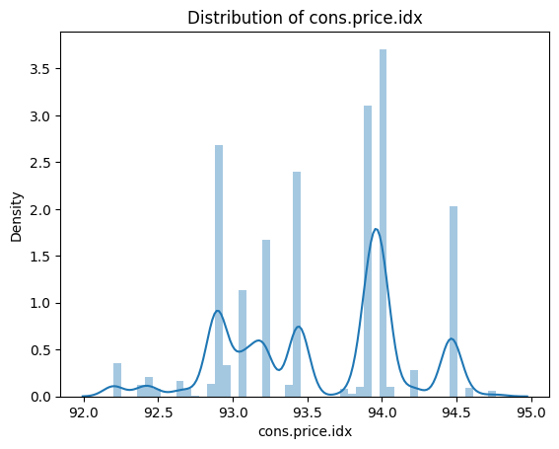
NUMERICAL DISTRIBUTIONS
The employment variation rate is usually between 1 and 2
The consumer price index in the dataset ranges from around 92 to 95, concentrated around 93 to 94

Slide 20
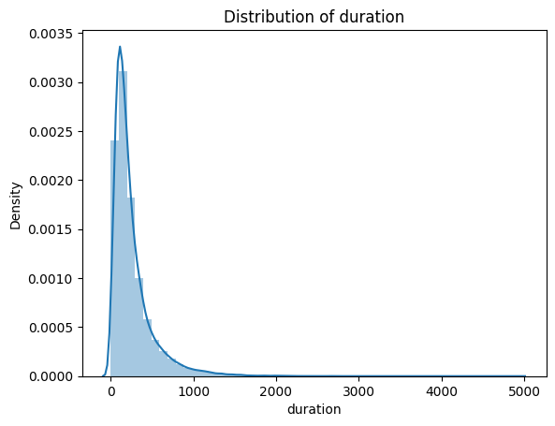
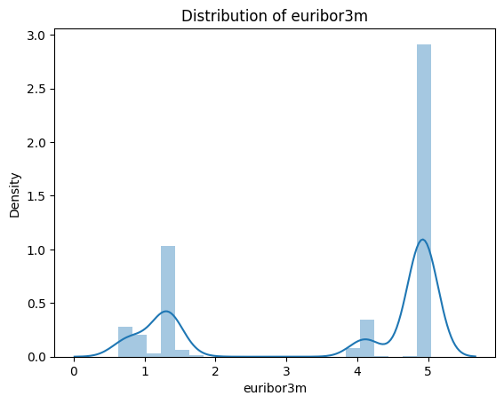
NUMERICAL DISTRIBUTIONS
The contact duration distribution is right-skewed between 0 and 1000 seconds
The distribution of the euribor 3 month rate is concentration around 5

Slide 21
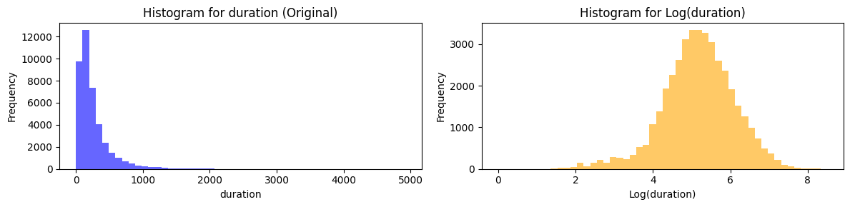
DURATION SKEWNESS
The durations variable when looking at its frequency in the dataset is quite skewed
When taking the log of duration, the distribution is much more normal

Slide 22
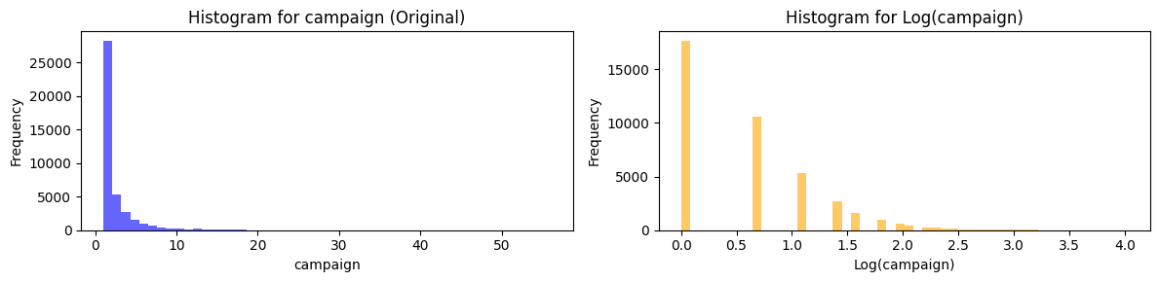
CAMPAIGN SKEWNESS
The campaign variable when looking at its frequency in the dataset is also quite skewed
When taking the log of campaign however, the distribution is still right-skewed

Slide 23
03
MODELS BUILDING

Slide 24
CLUSTERING MODEL:
Customers segmentation

Slide 25
CLUSTERING MODEL APPROACH
Testing 5 different clustering models with and without categorical variables. Incorporating those variable worsened our clustering so we only used numerical variables
Best Model | K-Means | Hierarchical | DBSCAN | GMM | Mean Shift
# of clusters | 5 | 5 | 21 | 2 | 6
Silhouette Score | 0.35491 | 0.33557 | 0.21273 | 0.36028 | 0.52538
Calinski Harabasz Score | 10622.31 | 9243.99 | 1135.64 | 8465.60 | 2190.69
Davies Bouldin Score | 1.1374 | 1.1622 | 1.8218 | 1.6198 | 1.5098

Slide 26
04
RESULTS & INTERPRETATION

Slide 27
CLUSTERING: BEST MODELS
Mean Shift
GMM
K-Means
Cluster 1 (3.4%): High engagement and success
-Higher Subscription Rates
-Active and Prior Contact
-Predominance of Cellular Communication
Cluster 0 (96%): Untapped potential -Untouched demographic (no prior contact) -Lower subscription rate and engagement
-Diversified demographic, less campaign contact
- Lower Interest rates
Cluster 1 (86%): Uncontacted
-No prior contact
-Higher interest rates -Less cellular contact Cluster 0 (14%): Previously Engaged
-Lower interest rate
-Previously contacted or engaged
-More subscribed but still a minority
Cluster 0 and 4 (87.4%)
-Most unsubscribed (94%)
-Telephone contact
-Less contact
Cluster 1 and 3 (24.8%)
-More successful
-More subscribed
-More cellular
Clustering results harder to grasp with K-means results

Slide 28
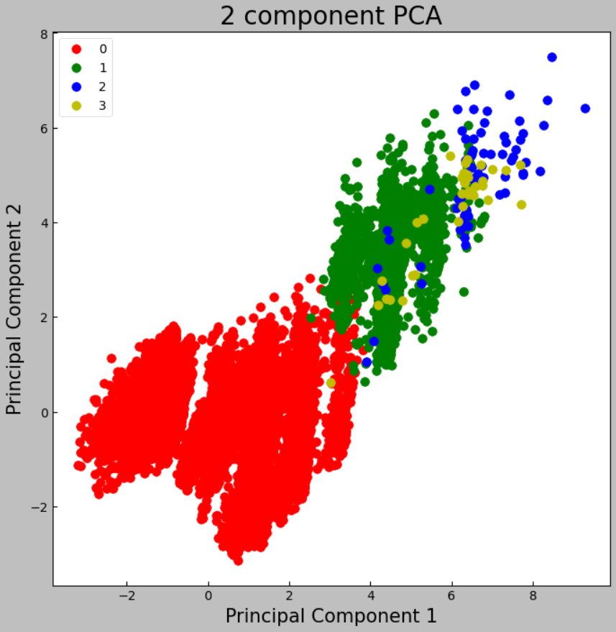
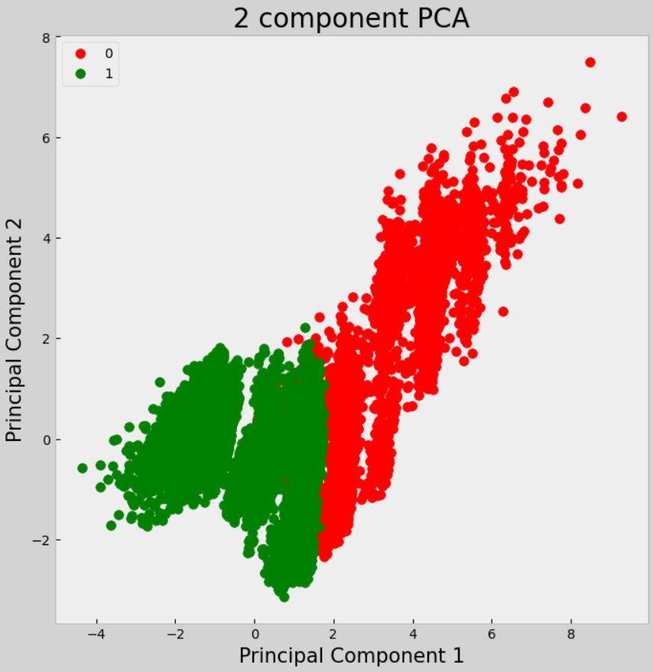
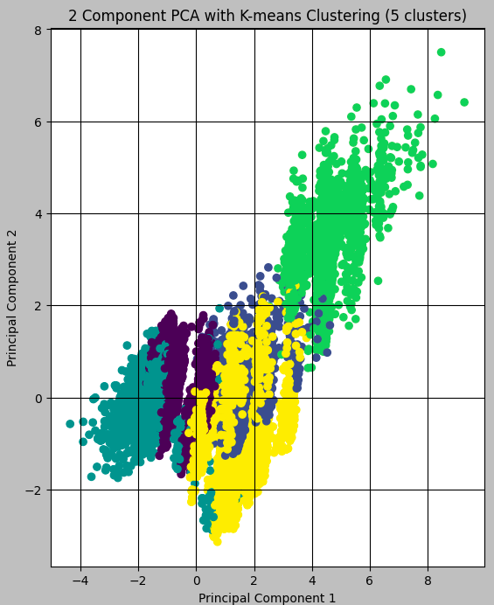
CLUSTERING: BEST MODELS
GMM
K-Means
Mean Shift
Main takeaways: Those “successful” clusters still have a number of non-subscribed users that can be a target demographic. Shows the importance of the economic situation rather than the demographic (no age, job or education pattern)

Slide 29
CLASSIFICATION MODEL:
Predict Subscription

Slide 30






MODELLING APPROACH
Approach
Model selection
Classification model to predict whether a customer has subscribed or not.
Try different models + hyperparameter tuning
Preprocessing
Validation strategy
- Create target
- Drop useless and correlated and variables
- Categorical encoding
- Standardize data
- Balance target variable
Train-validation-test split
Evaluation metric
Accuracy, precision, recall, F1 score, AUC-ROC
Feature selection
Random Forest to select features with importance above 0.02

Slide 31
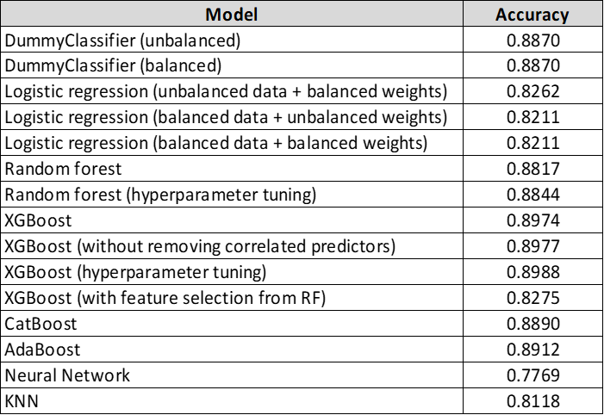
MODEL EVALUATION

Slide 32
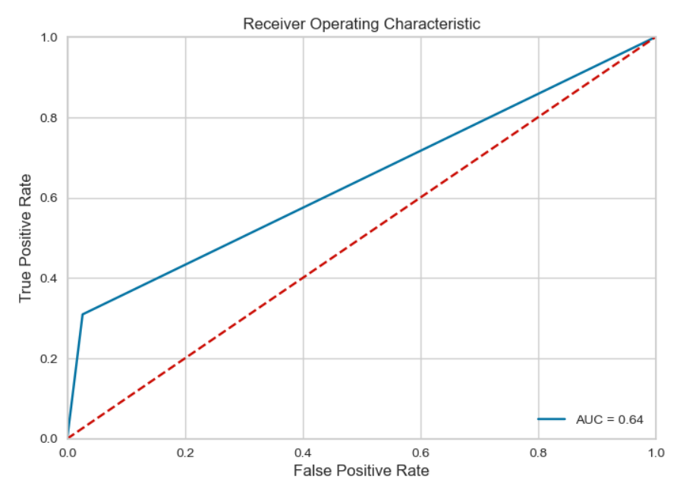
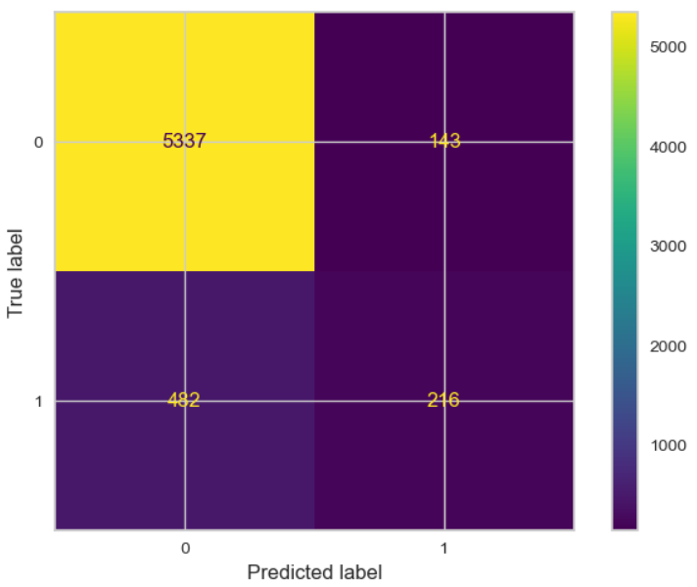
MODEL EVALUATION
Recall = 0.90
F1 score = 0.88
Because of the unbalanced nature of the dataset, Recall is a better metric than accuracy.
'colsample_bytree': 0.8, 'learning_rate': 0.2, 'max_depth': 7, 'n_estimators': 100, 'random_state': 42, 'subsample': 1.0
Notes:
Only accuracy is shown as a comparative but in the case of unbalanced data, recall and F1 score were the best metrics
Recall (TPR) is the number of true positive predictions divided by the total number of actual positive instances (true positives + false negatives).
It measures the ability of the model to capture all positive instances.

Slide 33
04
RESULTS & INTERPRETATION

Slide 34
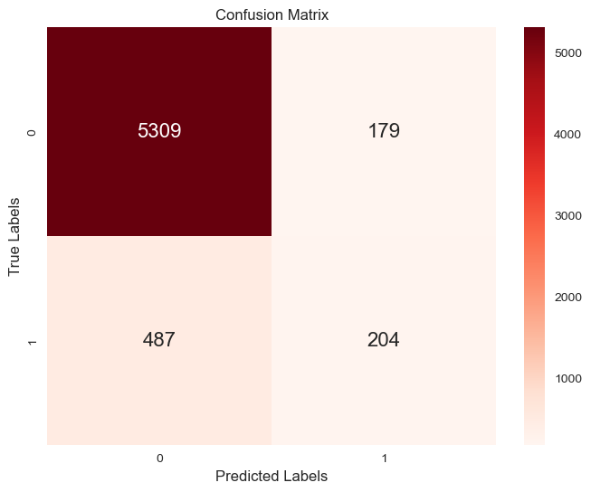
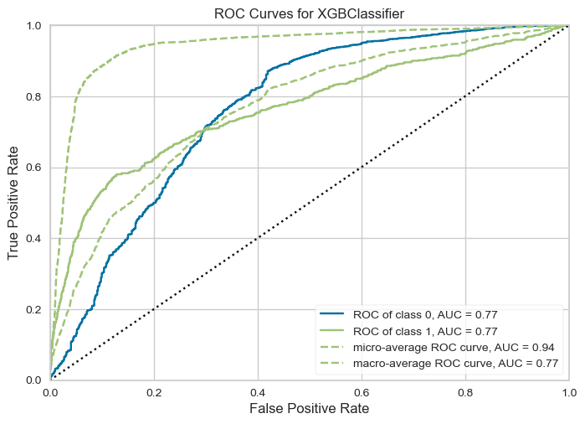
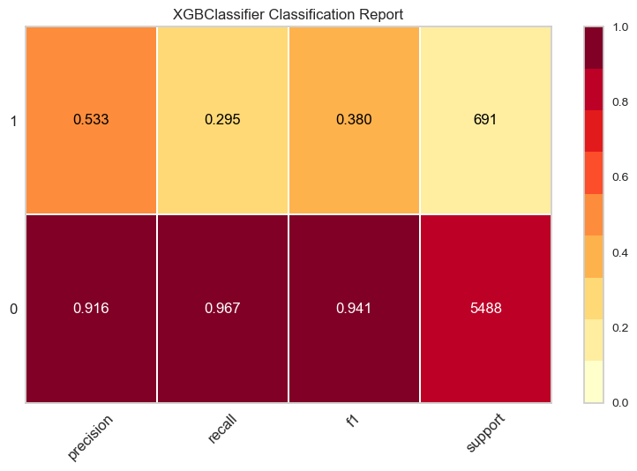
RESULTS ON THE TEST SET
Accuracy = 0.8922
Weighted avg recall= 0.89
Notes:
overall measure of a model's ability to discriminate between classes
A model above the diagonal line indicates better-than-random performance.
A higher AUC indicates better discrimination between classes. A perfect classifier has an AUC of 1, while a random classifier has an AUC of 0.5.

Slide 35
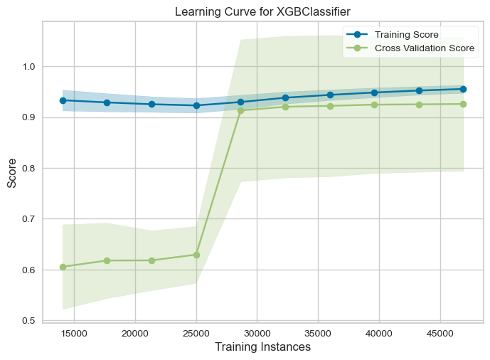
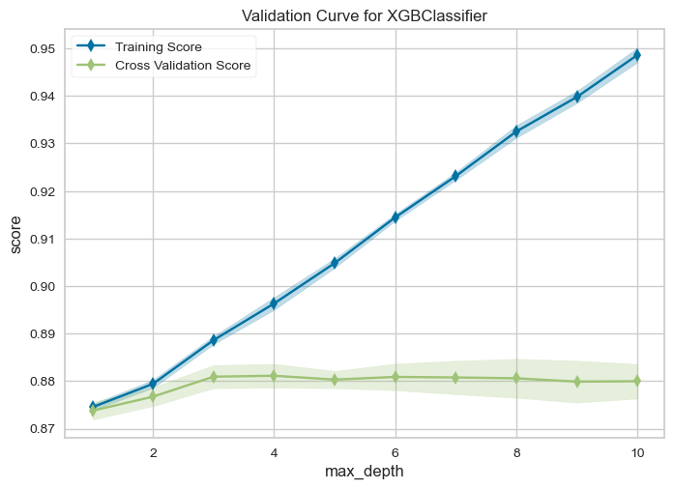
RESULTS ON THE TEST SET
Notes:
overall measure of a model's ability to discriminate between classes
A model above the diagonal line indicates better-than-random performance.
A higher AUC indicates better discrimination between classes. A perfect classifier has an AUC of 1, while a random classifier has an AUC of 0.5.

Slide 36
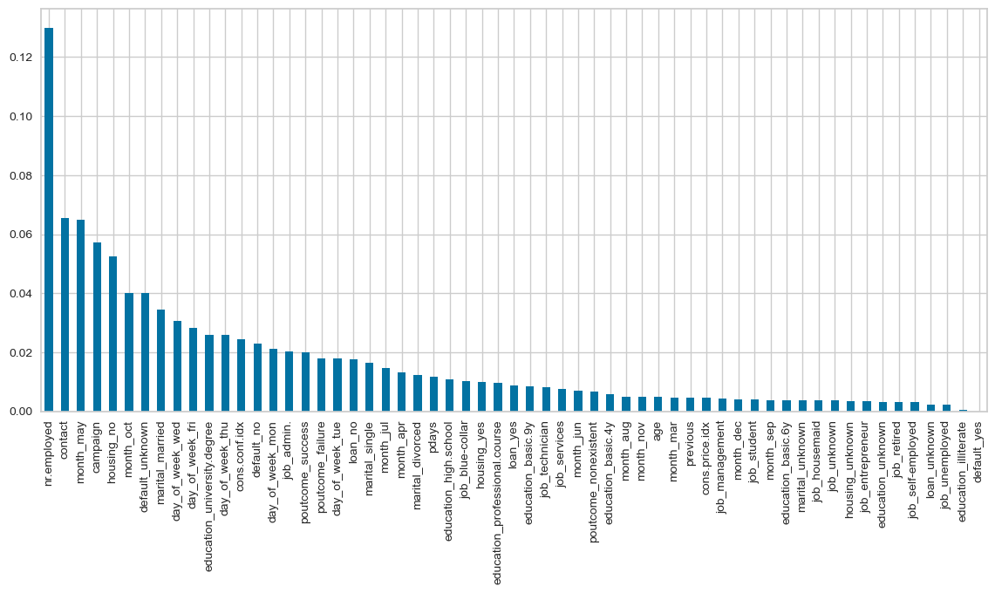
INTERPRETATION - FEATURE IMPORTANCE
Top 5 predictors:
Number of employees. Inherently, it is not expected to influence the customer directly. It is more of an indicator tied to the socio-economic context.
Being contacted on telephone (vs cellphone). When people are at home they have more time and are more open to having a conversation.
Being contacted in the month of May. May be related to tax seasons, or else. Also lots of Holidays during this month in Portugal.
Number of contacts during the campaign. The higher the number of contacts, the less likely a customer will subscribe (from SHAP plot).
Not having a housing loan
Notes:
nr.employed: number of employees
contact: 1=telephone, 0=cellular
Month_may (could be patterns related to tax seasons, or bonuses bc lots of holidays in May in Portugal)
campaign: number of contacts performed during this campaign and for this client
From SHAP plot: lower nb of contacts = more likely to subscribe to a term deposit
Higher nb of contacts = lesslikely to subscribe to a term deposit
Housing_no: has no housing loan
In the future :Partial Dependence Plots (PDP):
Create PDPs to visualize the effect of a single feature on the predicted outcome while keeping other features constant.

Slide 37
05
THREATS TO
VALIDITY

Slide 38
THREATS TO VALIDITY
Internal Validity:
Overfitting in Classification Models: Complex models might excel on training data but fail to generalize to new data, affecting predictions
Feature Selection Bias: Biased feature selection can hinder the model's ability to identify genuine predictive relationships
External Validity:
Population Validity: Data may not represent the entire customer base, impacting generalizability
Temporal Validity: Changes in customer behavior over time can affect model accuracy.Temporal features (such as interest rates) need a time associated to gather more insights.
Construct Validity:
Lack of Construct Diversity: Limited variables might oversimplify behaviors, missing key insights
Conclusion Validity:
Model Assumptions: Violating model assumptions can lead to inaccurate predictions

Slide 39
MITIGATION STRATEGIES
Cross-Validation: Employ techniques to assess generalizability and improve model robustness when compared to using train,test and split.
Diverse Data Collection: Ensure diverse datasets for better representation.
Continuous Model Evaluation: Regularly update models with new data to reflect changing behaviors.
Multi-Model Approach: Use various models to validate findings and uncover different behaviors.
Notes:
In the context of your data analytics project focusing on the banking environment, several threats to validity could impact the outcomes of both your classification and clustering models. Considering the business context and the hypotheses for your models, here are potential threats to validity:
### Threats to Internal Validity:
- **Overfitting in Classification Models**: If the classification model is overly complex, it might perform exceptionally well on training data but fail to generalize to unseen data, which is crucial for predicting customer behavior accurately.
- **Feature Selection Bias**: Choosing features based on existing assumptions rather than letting the data guide the selection process can introduce bias, impacting the model's ability to identify true predictive relationships.
### Threats to External Validity:
- **Population Validity**: The data used to train the models may not be representative of the entire customer base or potential customer base. For example, if the data is skewed towards a particular demographic, the findings might not generalize well to other segments.
- **Temporal Validity**: Customer behavior and responsiveness to marketing strategies can evolve over time. A model trained on historical data might not accurately predict future behaviors if it doesn't account for these changes.
### Threats to Construct Validity:
- **Inadequate Operationalization of Constructs**: The way in which customer engagement or the propensity to subscribe to a term deposit is defined and measured may not fully capture the constructs' complexities. This can lead to misinterpretation of the model's outputs.
- **Lack of Construct Diversity**: Relying on a limited set of variables to represent complex behaviors and preferences can oversimplify the reality, potentially missing out on critical insights that could inform more effective marketing strategies.
### Threats to Conclusion Validity:
- **Insufficient Sample Size**: If the dataset is too small or not diverse enough, there may be insufficient power to detect significant differences or patterns, leading to incorrect conclusions about the effectiveness of marketing strategies.
- **Model Assumptions**: Both classification and clustering models come with underlying assumptions (e.g., independence of features, distribution of data points). Violation of these assumptions can lead to inaccurate predictions and clustering results.
### Mitigation Strategies:
- **Cross-Validation and Regularization**: Implement cross-validation techniques to assess the model's generalizability and use regularization to prevent overfitting.
- **Diverse Data Collection**: Ensure the dataset includes a wide range of customer interactions and profiles to improve representativeness.
- **Continuous Model Evaluation**: Regularly update and re-evaluate the models with new data to account for changing customer behaviors and market conditions.
- **Multi-Model Approach**: Utilize a variety of models to cross-validate findings and uncover different aspects of customer behavior and segmentation.
By acknowledging and addressing these threats to validity, you can enhance the reliability and applicability of your models to achieve more effective, data-driven marketing strategies in the banking sector.

Slide 40
06
CONCLUSION & NEXT STEPS

Slide 41

ACHIEVING BUSINESS GOALS
Classification
Clusters
XGBoost had the highest performance among classification models, indicating its effectiveness in handling the complexity and nuances of the bank marketing dataset
Ability to target customers according to feature importance, the bank can now readily identify which criteria are most crucial for customer subscriptions.
K-Means and Mean Shift exhibited the highest silhouette scores, offering valuable insights into client segmentation by revealing distinct groups that can be effectively targeted with customized marketing strategies.
We identified that economic circumstances are predominant over demographics, as evidenced by the presence of non-subscribed users within "successful" clusters, highlighting the importance of economic factors over demographic variables such as age, occupation, or education.
Subscribe to term deposit
Not Subscribe

Slide 42
LESSONS LEARNED
Data Preparation
Complexity
Experiment
Our project showed the importance of thorough data cleaning, preprocessing, and balancing to be able to build effective machine learning models and get the most insights
The incremental performance gains that we get with more complex models versus simpler models should always be weighed against interpretability and computational demands; some of our models were less interpretable or more computationally intensive, taking very long to run
The process of examining a wide range of models and strategies, including different techniques for balancing data and clustering algorithms, played a crucial role in identifying the best approach that was specifically tailored to our context.

Slide 43
NEXT STEPS
Collect additional data, especially related to any economic changes or client behavior trends, to refine our models and find new predictive features
Delve deeper into the underlying factors influencing subscription rates and client engagement, requiring further analysis and interpretation.
Look into testing other types of classification or clustering models, e.g. mean shift was a completely new clustering technique we hadn’t learned before, but performed extremely well
Implement some cross-validation techniques to assess our models’ stability and performance across different subsets of data

Slide 44
THANKS!
Q&A

Slide 45
APPENDIX

Slide 46
GMM
Feature | Cluster 0 | Cluster 1
pdays | Varied, with an average of ~731 | All have never been contacted (999)
previous | Higher, mean ~ 1.27 | Lower, effectively 0
euribor3m | Lower, mean ~ 1.49 | Higher, mean ~ 3.96
Subscribed | Yes: 26.65%, No: 73.35% | Yes: 8.83%, No: 91.17%
poutcome | Failure: 75.59%, Success: 24.41% | Nonexistent: 100%
Contact Type | Cellular: 92.84%, Telephone: 7.17% | Cellular: 58.83%, Telephone: 41.17%

Slide 47
MEAN SHIFT
Feature | Cluster 0 | Cluster 1
pdays | 999 (no prior contact) | Varied, suggesting some prior contacts
previous | Lower, indicating fewer or no previous contacts | Higher, indicating repeated engagement
euribor3m | Mixed rates, with cluster-specific means | Mixed rates, with cluster-specific means
Subscribed | Yes: 9.26%, No: 90.74% | Yes: 63.78%, No: 36.22%
poutcome | Nonexistent: 89.70%, Failure: 10.30% | Success: 90.35%, Failure: 9.65%
Contact Type | Cellular: 62.36%, Telephone: 37.64% | Cellular: 92.78%, Telephone: 7.22%

